Slide 1
IOT BASED CHILD SAFETY GADGET FOR CHILD SAFETY MONITORING AND NOTIFICATION
Team ID: PNT2022TMID01828
Team Lead: Sabarinathan G
Team Members: Pathmaloshan C, Praneeth R, Rithik M

Slide 2
INTRODUCTION
Now a days parents are busy with their daily routine they are not able to concentrate on so much attention to their child safety.
In a modern day world we came up with an idea of creating an IOT device to monitor the child location with a geofence.
In this device the parents are able to monitor the child location lively and they know that their child is in the safe zone or not.

Slide 3
OBJECTIVE OF OUR PROJECT
Child tracker helps the parents in continuously monitoring the child’s location.
They can simply leave their children in school or parks and create a geofence around a particular location.
By continuously checking the child’s location notifications will be generated if the child crosses the geofence.
Notifications will be send to the sent according to the children location to their parents and caretakers.

Slide 4
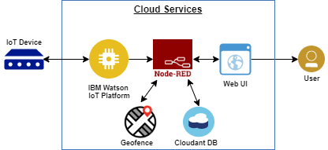
BLOCK DIAGRAM

Slide 5

METHODOLOGIES
Python
IBM Watson Cloud
Node-Red
MIT app Inventor
Cloudant db

Slide 6
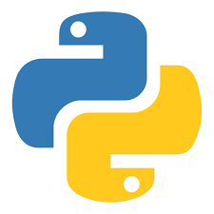
PYTHON
We have to develop a python script to monitor the child location and then we have to create the geofence.
After creating the geofence we have to develop an alerting notification if the child crosses the geofence and also check the temperature value of the child surroundings.

Slide 7
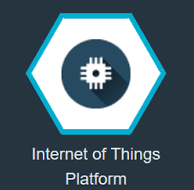
IBM WATSON
IBM Watson IoT Platform is a fully managed, cloud-hosted service that makes it simple to derive value from Internet of Things (IoT) devices.
Configure the connection security and create API keys that are used in the Node-Red service for accessing the IBM platform.
Python program is linked to the IBM Watson IOT platform.

Slide 8
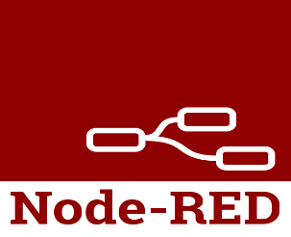
Node-Red
Node-RED is a programming to create functionality by wiring together flows of data between nodes using a browser.
It has gained tremendous popularity in the IoT space, by modeling bits of application functionality between IoT devices like sensors, cameras, and wireless routers.
In our project the node-red is used to connect the app and the IBM Watson.

Slide 9

MIT APP INVENTOR
MIT App Inventor is a web application integrated development environment originally provided by Google, and now maintained by the Massachusetts Institute of Technology.
We have to develop a app in MIT app inventor.
And then we have to connect the node red and the MIT app inventor.
The MIT app inventor displays the collected information.

Slide 10

CLOUDANT DATABASE
Create a Dashboard for storing the child location
It collects all the data obtained from the IBM Watson, Node red and the MIT app inventor and store it.

Slide 11
DEMONSTRATION VIDEO
GitHub Link: https://github.com/IBM-EPBL/IBM-Project-14257-1659547456/tree/main/FINAL%20DELIVERABLE
MIT App APK File Link: https://drive.google.com/u/1/uc?id=1aH_4e1wuKVZs8d79vqCFjdxVT8m_t4vZ&export=download
Project Demonstration Video Link: https://drive.google.com/file/d/1SK2nOhzfaPgK4-jvZe4QCmmlAWn5jOH_/view?usp=sharing

Slide 12

FUTURE SCOPE
Child’s surrounding can be located with the help of accurate and precise real time location.
Surrounding environment temperature,SOS light along with distress buzzers are provided in this system.
If child crosses the geofence call goes to the registered mobile numbers

Slide 13
REFERENCE
Proceedings of the Third International Conference on Intelligent Communication Technologies and Virtual Mobile Networks (ICICV 2021).Design of Wearable Device for Child Safety
Proceedings of 3rd international conference on Integrated Intelligent Computing and Communication & Security (ICIIC 2021)IOT based child security monitoring system
2016 Second International Conference on Computational Intelligence & Communication Technology- Child Safety & Tracking Management System.
2020 IEEE 14th International Conference on Semantic Computing (ICSC) -IOT-enabled Smart Child Safety Digital System Architecture

Slide 14
Thank You

